Slide 1
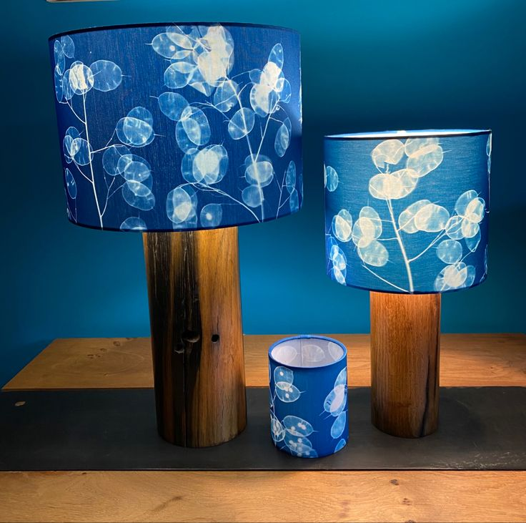
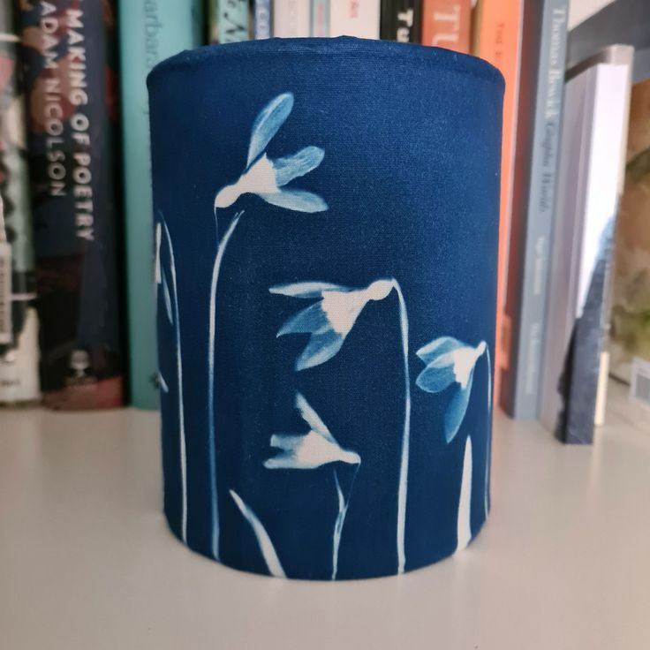
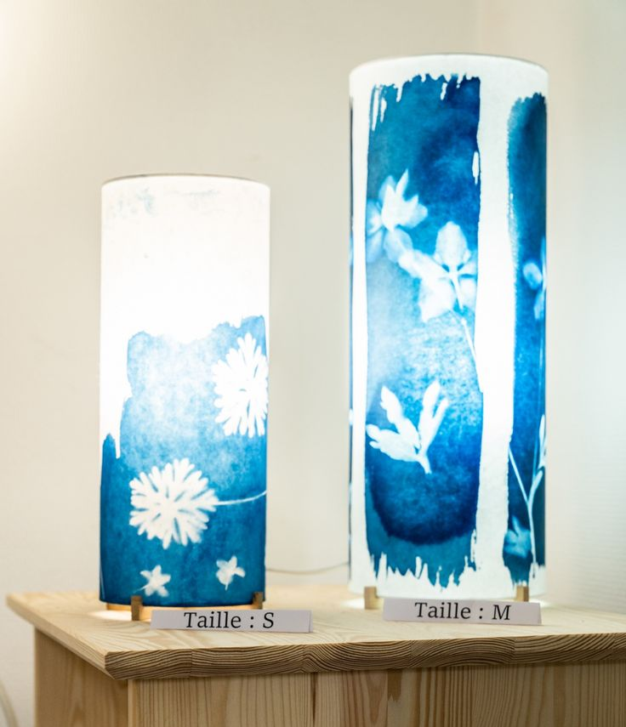

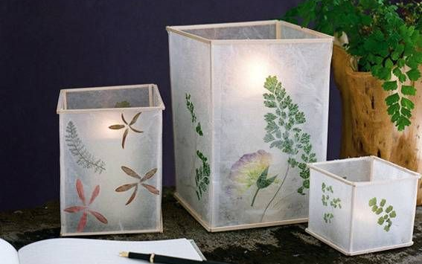
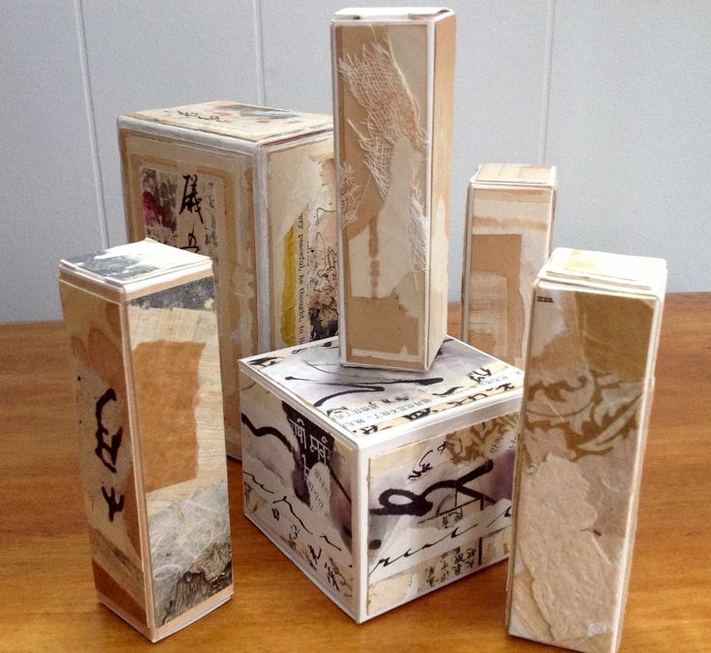
Lantern Design Lesson Instructions
STEP 1: Enlarge Your A4 Design
Take your original A4 black and white design and photocopy it at a larger scale.
Produce 1 original + 3 altered versions of your design using the photocopier.
Play with enlargement, cropping, repetition, and rotation.
Adjust the darkness settings on the copier to level 3 for maximum contrast.
Look closely at how design elements (line, shape, pattern, contrast) emerge in new and interesting ways as you manipulate the original.
STEP 2: Design Your Lantern Structure
While you're waiting for the photocopier:
Begin planning what your final lantern will look like.
Will it be a cylinder, square, or another geometric form?
Will you create one large lantern, or a series of 2 or 3 smaller ones in different sizes and shapes?
Use your SKETCHBOOK to sketch out your ideas. Annotate with dimensions!
Refer to examples!
Think about how your altered designs will wrap or fold into your chosen structure.

